Slide 1
Network Embedding: Problems, Methodologies and Frontiers
Peng Cui (Tsinghua University)
Wenwu Zhu (Tsinghua University)
Jian Pei (Simon Fraser University)

Slide 2
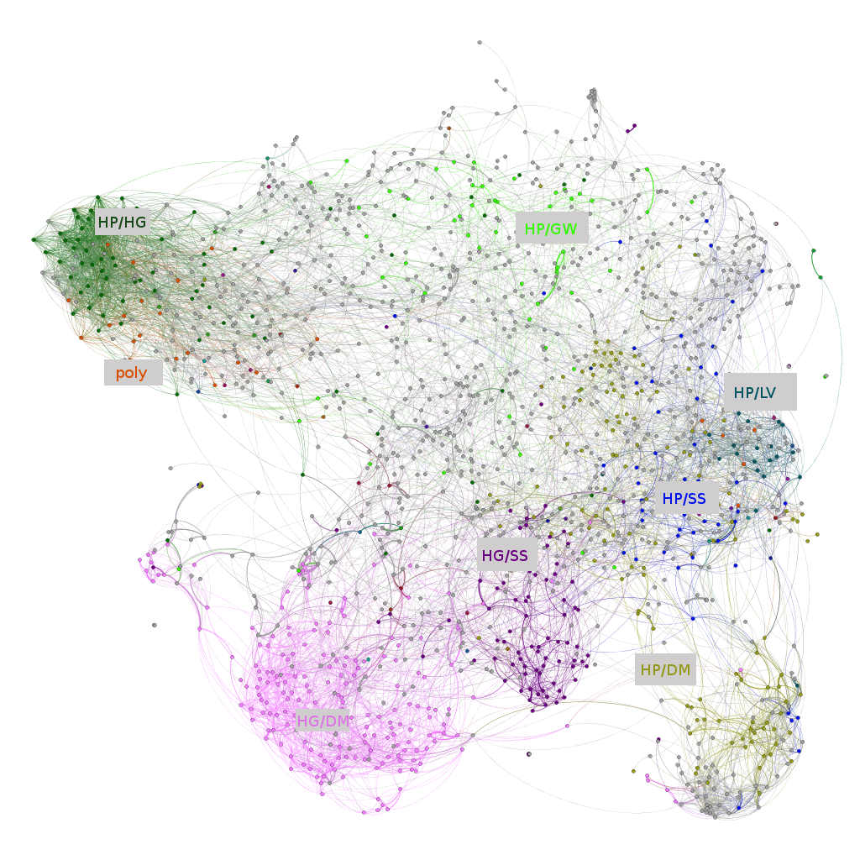
Network Analytics
Descriptive and Predictive
Node importance
Community detection
Network distance
Link prediction
Node classification
Network evolution
…
Network analytics technology has vital impact on many real applications.

Slide 3


The voices from industry…
Social Networks
Facebook: ~2 billion active users
Wechat: ~1 billion active users
E-commerce Networks
Amazon: 400M active customers, 400M
products
JD.com: 300M customers, 800M products
Many networks grow to such a scale that sophisticated network analytics become infeasible.
Notes:
描述网络规模
Facebook, twitter

Slide 4
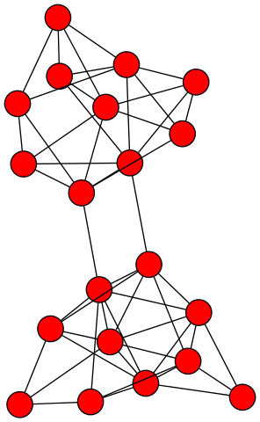
What is the bottleneck?
G = ( V, E )
Iterative &
Combinatorial
Complexity
Links
Coupling
Parallelizability
Dependency among nodes
Applicability of ML methods

Slide 5
Revisit network representation
G = ( V, E )
G = ( V )
Vector Space
generate
embed
Easy to parallel
Can apply classical ML methods

Slide 6
The ultimate goal of network embedding
Network Inference
Node importance
Community detection
Network distance
Link prediction
Node classification
Network evolution
…
in Vector Space

Slide 7
How?
The vector space should be able to…
Goal 1 Reconstruct the original network
Goal 2
Support network inference
Network Embedding
Notes:
In order to do that, we set two goals for network embedding. The first one, is to reconstruct the original network in the embedding space, and the second one, is to support network inference in the embedding space. So we investigated network embedding methods to realize these two goals.

Slide 8
Network Embedding
Goal 1 Reconstruct the original network
Matrix Factorization
Adjacency Matrix
Embedding Matrix
Reconstruct all the links? May cause overfitting.
The network inference ability is seriously limited.
Notes:
Actually, network embedding is not a new topic. But most of the previous works focus on the first goal, to find an embedding space to reconstruct the original network. For example, matrix factorization is a typical network embedding method. The network is represented by adjacency matrix. After decomposing the adjacency matrix through SVD, we can get the embedding matrix. From the objective function, we can see that the aim of the embedding is to optimally reconstruct all the observed links. That means, we want to find a embedding space to overfit the network. In such an embedding space, the network inference ability is seriously limited.

Slide 9
Network Embedding
Goal 1 Reconstruct the original network
Problems still exist.
Network Inference
Network Embedding
Node importance
Community detection
Network distance
Link prediction
Node classification
Network evolution
…
Network
Reconstruction
Network
Inference
Notes:
Actually, network embedding is not a new topic. But most of the previous works focus on the first goal, to find an embedding space to reconstruct the original network. For example, matrix factorization is a typical network embedding method. The network is represented by adjacency matrix. After decomposing the adjacency matrix through SVD, we can get the embedding matrix. From the objective function, we can see that the aim of the embedding is to optimally reconstruct all the observed links. That means, we want to find a embedding space to overfit the network. In such an embedding space, the network inference ability is seriously limited.

Slide 10
Network Embedding
Goal 2 Support network inference
Network Inference
Network Embedding
Node importance
Community detection
Network distance
Link prediction
Node classification
Network evolution
…
Enabling network inference
in vector space
Notes:
分2页，1.0和2.0的区别

Slide 11
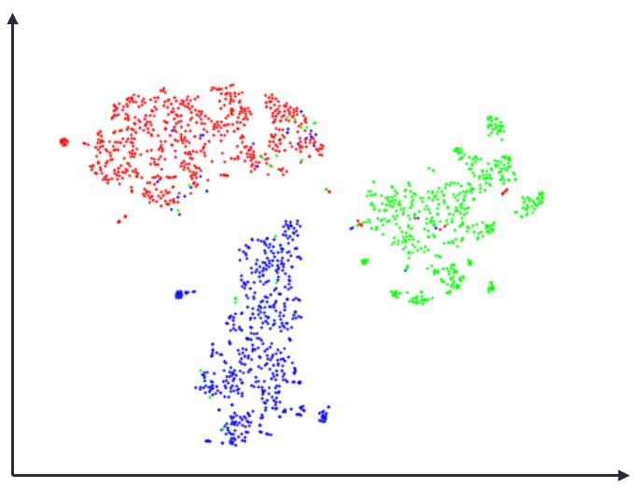
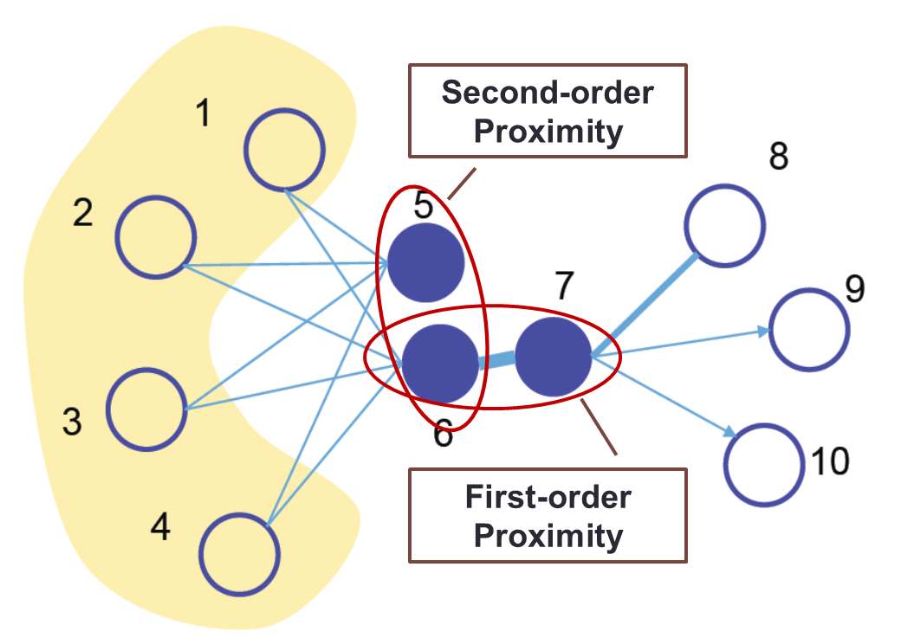
Network Embedding
Goal 2 Support network inference
Reflect network structure
Maintain network Properties
B
A
C
Transitivity
Notes:
分2页，1.0和2.0的区别

Slide 12
Graph Embedding v.s. Network Embedding
What’s the difference between graph embedding and network embedding?
Why graph embedding cannot fulfill the goals of network embedding?

Slide 13
Graph v.s. Network
In some sense, they are different.
Graphs exist in mathematics. (Data Structure)
Mathematical structures used to model pairwise relations between objects
Networks exist in the real world. (Data)
Social networks, logistic networks, biology networks, transaction networks, etc.
A network can be represented by a graph.
A dataset that is not a network can also be represented by a graph.

Slide 14
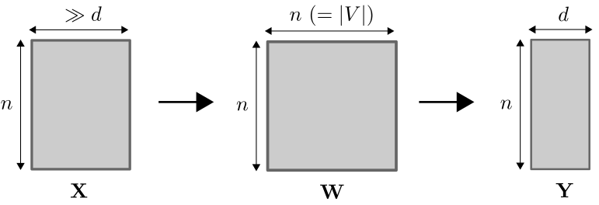
Graph Embedding
Graph embedding is initially proposed as a dimensionality reduction technique.
A graph, represented as an n*n proximity matrix, is first constructed based on features of the n samples.
After that, low-dimensional representations for the n samples are derived from the constructed graph.

Slide 15
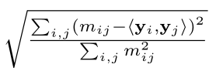
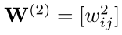
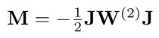
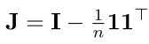
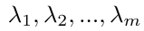
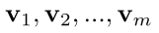
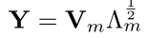
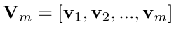
Multidimensional scaling (MDS)
MDS learns representations that minimizes:
Algorithm steps:
Step 1. Compute squared similarity:
Step 2. Remove means from rows and columns, i.e. centering.
Result: a normalized proximity matrix, M.
Step 3. Pick d largest eigenvalues of M and their eigenvectors.
Step 4. Get representations via:
is the diagonal matrix of m largest eigenvalues.

Slide 16
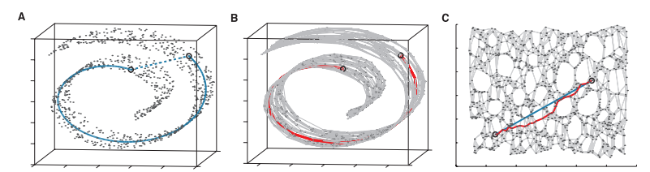
Isomap
Construct graphs from datasets, and then use MDS for graph embedding, with the aim of dimensionality reduction.
Step 1. Construct a neighborhood graph.
For each point, pick K nearest points as its neighbors.
Connect two neighboring points in the graph.
Euclidean distance between features as edge length.
Step 2. Compute shortest path between two nodes.
Store results as an n*n distance matrix.
Step 3. Apply MDS on the distance matrix to learn representations.
High Complexity

Slide 17
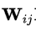
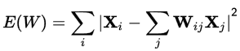
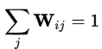
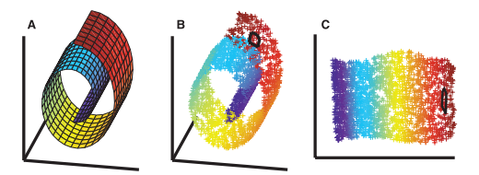
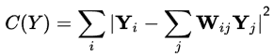
Locally Linear Embedding
To avoid explicit pair-wise proximity calculation.
Step 1. Construct a neighborhood graph (same as Isomap).
Step 2. Set edge weights as follows:
Fix between non-neighboring points as zero.
Learn for neighboring nodes by minimizing:
under the constraint that
Step 2. Learn representations by minimizing:
Notes:
LLE: local linear embedding
这四个方法递进的写下来

Slide 18
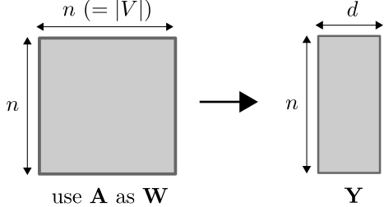
Applying graph embedding to networks
We can also directly apply graph embedding on a real-world network, e.g. a social network.
W is no longer constructed from features, but from network topology. For example, we can use the adjacency matrix as W.

Slide 19
Why Graph Embedding Performs Poorly?
Success of graph embedding depends on the quality of W
For graph embedding, W is constructed from dataset.
W_{uv} captures quite precisely how similar u and v are.
The adjacency matrix of a real-world network is not a good proximity matrix.
A_{uv} describes how frequent u and v interact with each other.
A_{uv} roughly correlates with similarity(u, v) – but only roughly.
A_{uv} = 0 can frequently happens even if u and v are similar.
A_{uv} < A_{uw} does not guarantee that w is more similar to u than v.
…
We need to find a better approximation of W than A.
Notes:
前面加一页总结前四种方法

Slide 20
So many ways to define network proximities…
Co-occurrence (neighborhood)

Slide 21
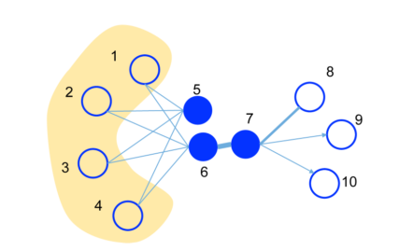
So many ways to define network proximities…
High-order proximities

Slide 22
So many ways to define network proximities…
Communities

Slide 23
So many ways to define network proximities…
Labels and attributes

Slide 24
So many ways to define network proximities…
Heterogeneous networks

Slide 25
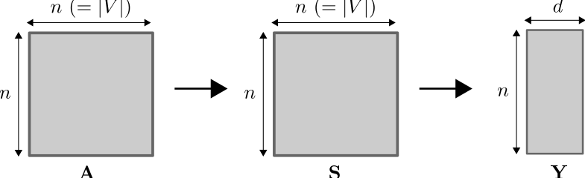

Graph Embedding v.s. Network Embedding
Graph embedding: Proximity is well defined.
Embedding
Network embedding: Proximity need to be subtly designed.
Proximity
approximation
Embedding
$$\hat{W}$$
Notes:
S->\hat W
箭头上加标注

Slide 26
Outline
Structure-preserved network embedding
Property-preserved network embedding
Dynamic network embedding

Slide 27
Outline
Structure-preserved network embedding
Property-preserved network embedding
Dynamic network embedding

Slide 28
Network Structures
Nodes & Links
Node Neighborhood
Pair-wise Proximity
Community Structures
Hyper Edges
Global Structure

Slide 29
Network Structures
Nodes & Links
Node Neighborhood
Pair-wise Proximity
Community Structures
Hyper Edges
Global Structure

Slide 30
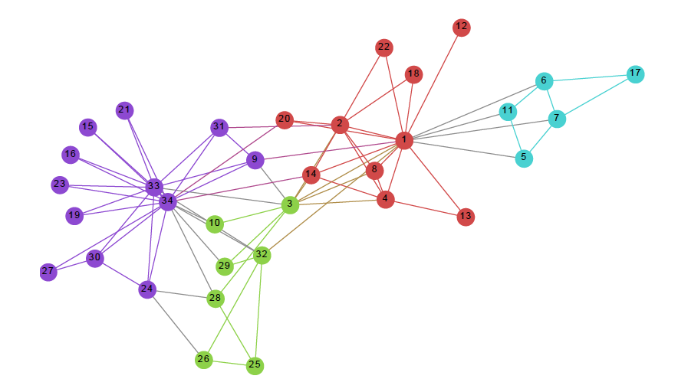
Node neighborhood
Node neighborhood is important in networks.
Node embedding should be able to reflect neighborhood.
How to define neighborhood in networks?
Notes:
Neighborhood is important.

Slide 31
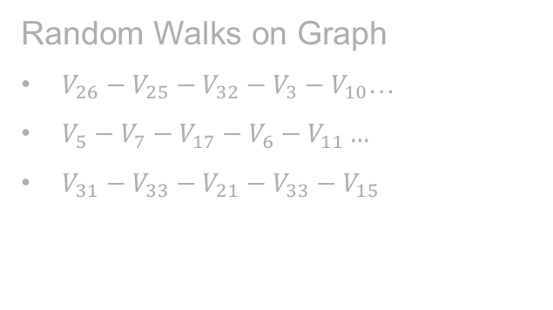
Deepwalk
Exploit truncated random walk to define neighborhood of a node.
Random Walks on Graph
$V_{26}−V_{25}−V_{32}−V_{3}−V_{10}$…
$V_{5}−V_{7}−V_{17}−V_{6}−V_{11}…$
$V_{31}−V_{33}−V_{21}−V_{33}−V_{15}$
B. Perozzi et al. Deepwalk: Online learning of social representations. KDD 2014.

Slide 32
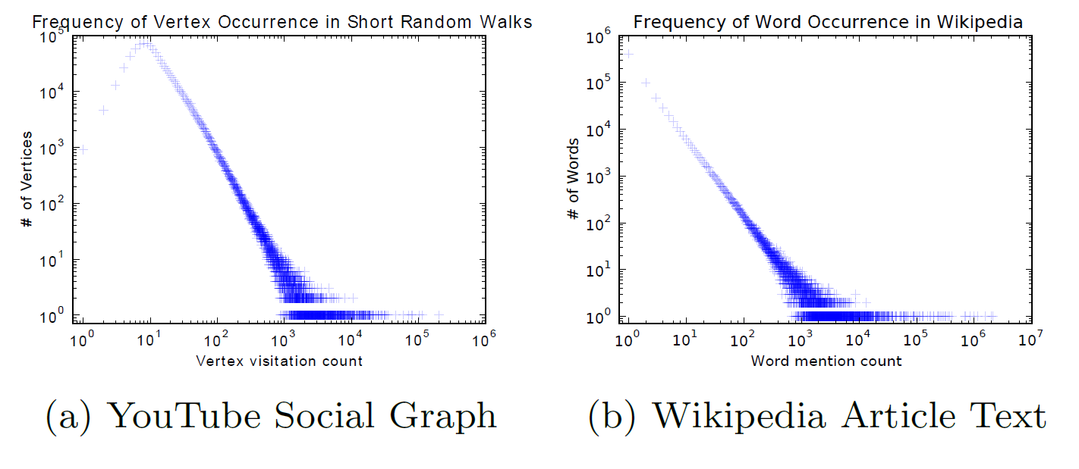
Deepwalk
Random walk on networks can generate similar power law distributions as word distributions in text.
B. Perozzi et al. Deepwalk: Online learning of social representations. KDD 2014.

Slide 33
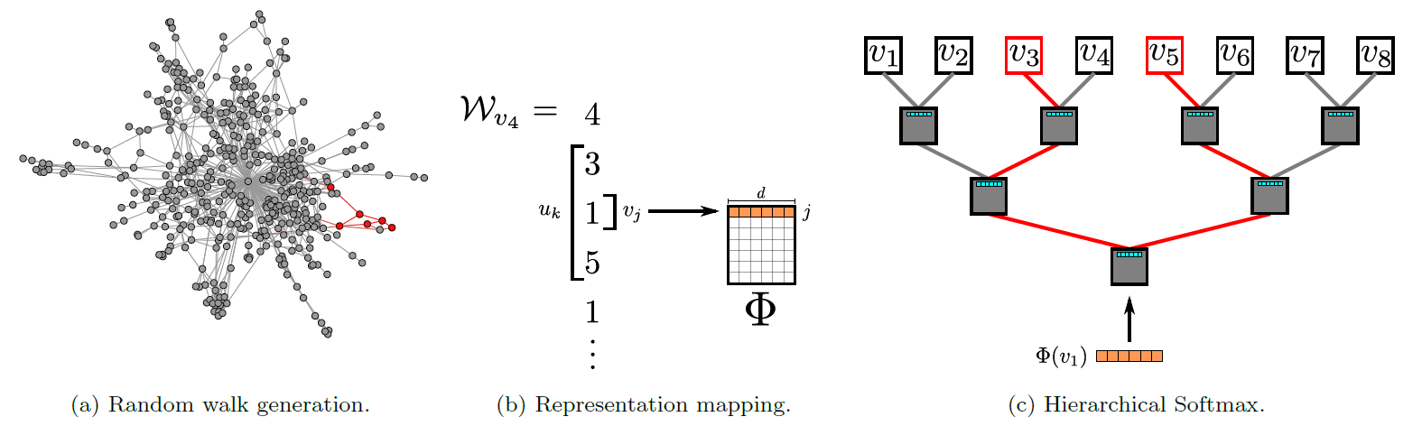
Deepwalk
DeepWalk: preserve social relation in vector space
Context: truncated random walk
Model: word embedding (Skip-gram)
B. Perozzi et al. Deepwalk: Online learning of social representations. KDD 2014.

Slide 34
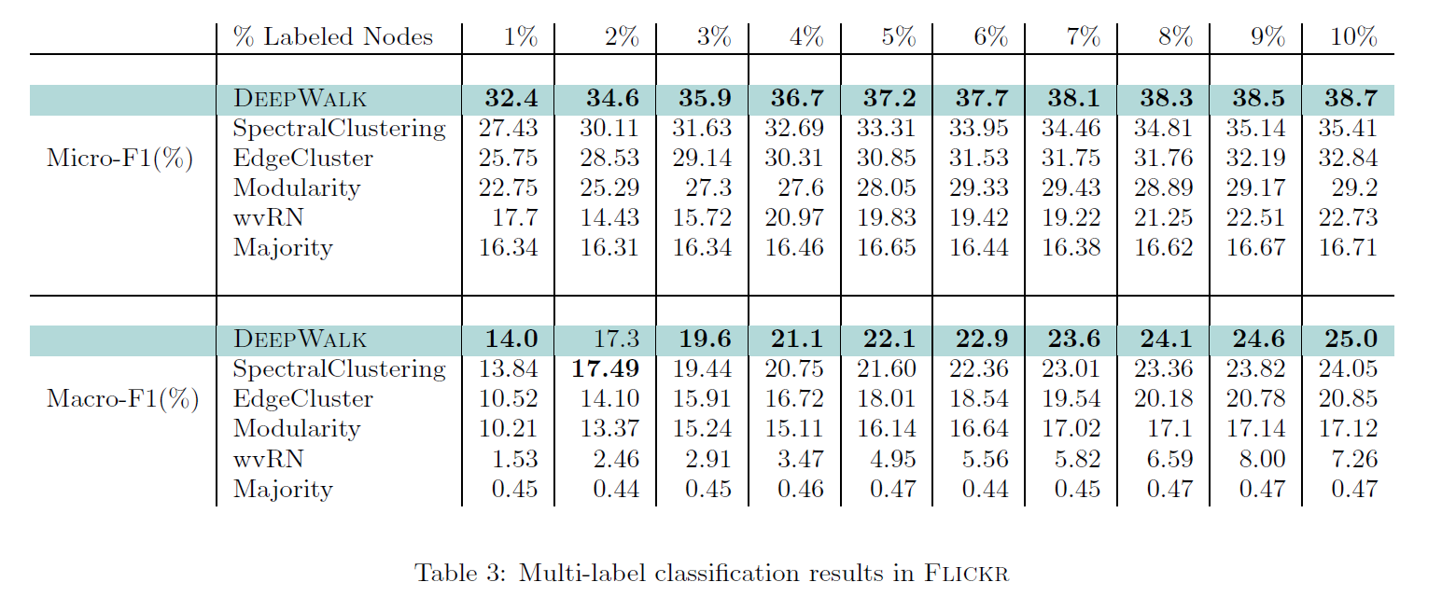
Deepwalk
Advantages:
Generalization of language modeling
Scalable
B. Perozzi et al. Deepwalk: Online learning of social representations. KDD 2014.

Slide 35
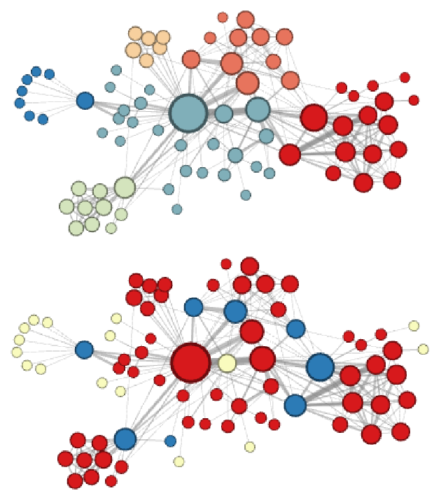
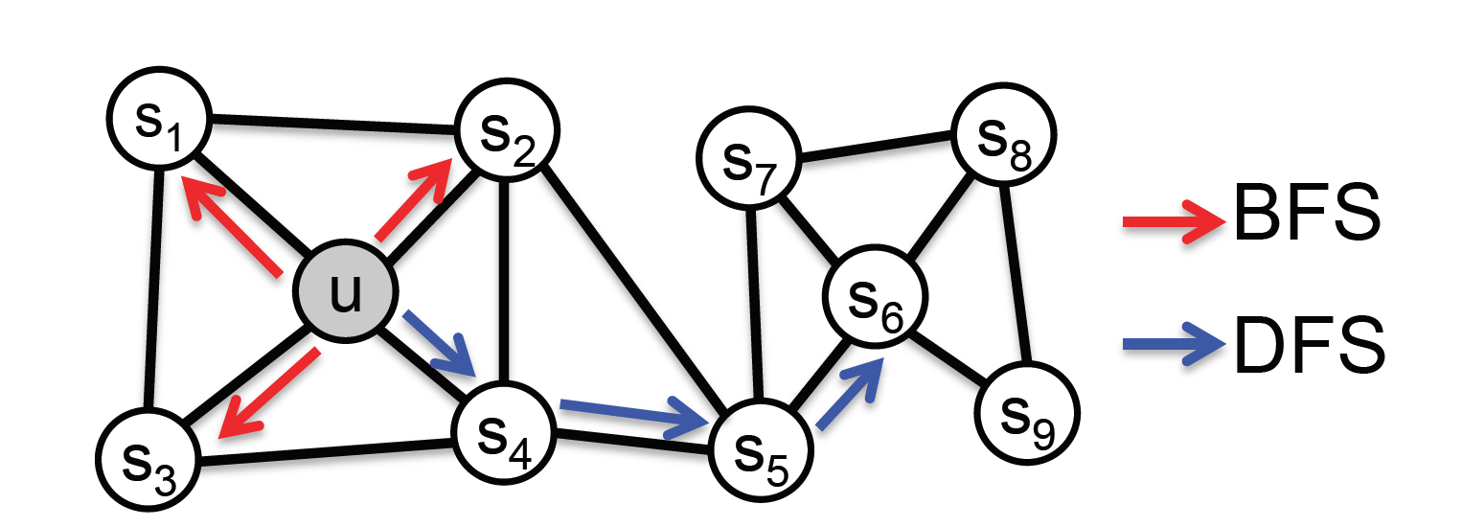
Node2vec
Social Relations:
Homophily (community): DFS search
Structural equivalence: BFS search
A. Grover et al. node2vec: Scalable Feature Learning for Networks. KDD 2016.

Slide 36
Network Structures
Nodes & Links
Node Neighborhood
Pair-wise Proximity
Community Structures
Hyper Edges
Global Structure

Slide 37
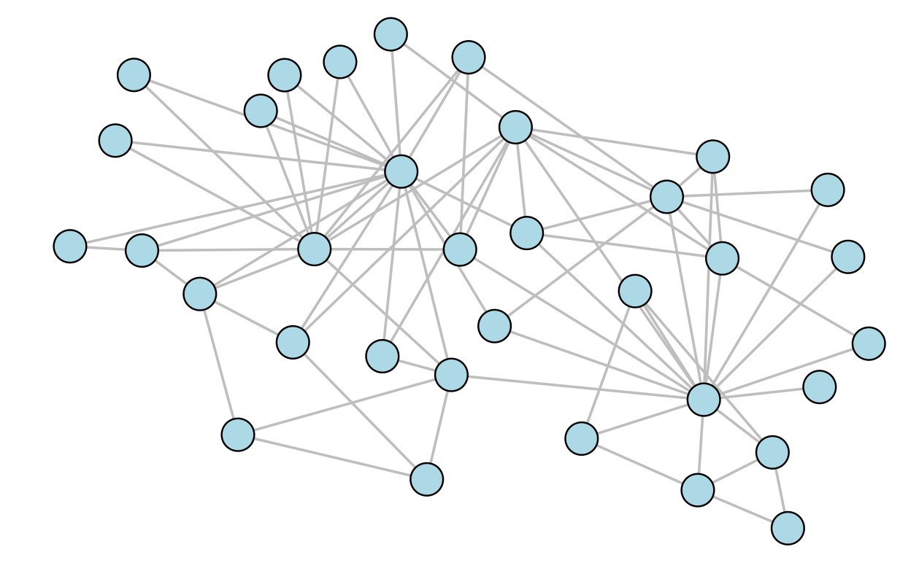
High-Order Proximity
key in capturing the underlying structure of networks
Advantages:
Solve the sparsity problem of network connections
Measure indirect relationship between nodes
Notes:
数学：传递性；社会学：三角闭合

Slide 38
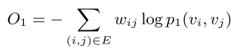
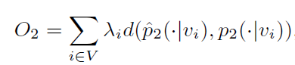
LINE
LINE with First-order Proximity:
local pairwise
LINE with Second-order Proximity:
neighborhood structures
Jian Tang et al. LINE: Large-scale Information Network Embedding. WWW 2015.

Slide 39
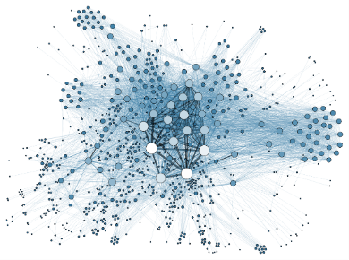
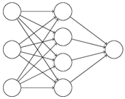
Structural Deep Network Embedding
Idea
Challenges
How to deal with network data in deep neural networks?
How to preserve the first and second-order proximity in deep neural networks?
solve non-linearity problem
preserve structure
first-order proximity
constrain
second-order proximity
Networks
Deep Neural Network
Deep Network Embedding
Structural Network Embedding
Daixin Wang et al. Structural Deep Network Embedding. KDD, 2016.

Slide 40
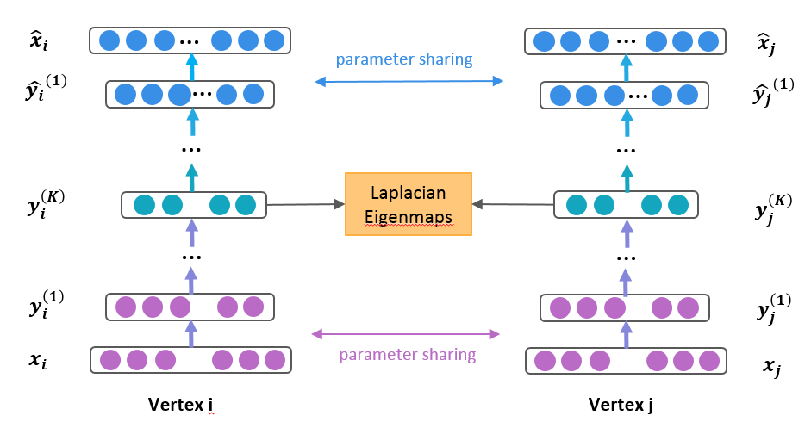
Framework of SDNE
Supervised Constraint
(preserve first-order proximity)
Unsupervised Autoencoder
(preserve second-order proximity)
Unsupervised Autoencoder
(preserve second-order proximity)

Slide 41
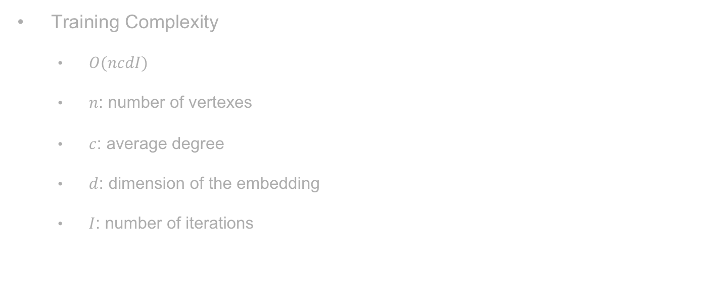
Complexity
Training Complexity
$O(ncdI)$
$n$: number of vertexes
$c$: average degree
$d$: dimension of the embedding
$I$: number of iterations
Training complexity is linear to the number of vertexes.

Slide 42
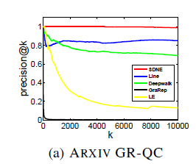
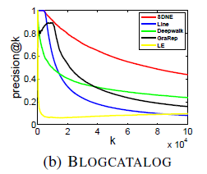
Task1: Network Reconstruction
Experiment Setup
Results and Discussion
Learn network representations
predict the existing links
(nearest neighbor)
improve 16%
improve 85%
Notes:
We report the precision@k in the following two figures. The red curve is the performance of our model and the higher the curve is, the better the performance is. We can see that our method outperforms baselines by 16% on Arxiv and by 85% on Blogcatalog. Specifically, our method can perfectly reconstruct the Arxiv dataset. It demonstrates that deep models can well reconstruct the network.

Slide 43
Task2: Node Classification
Experiment Setup
Results
Learn network representations
Train Linear Classifier
Classify the test data
averaged improve 12%
averaged improve 14%
improve 18%
improve 10%
improve 25%
improve 15%
Classification performance on Blogcatalog.
Notes:
We report the F1 score on the following two figures. The red curve is the performance of our paper and the higher the curve is, the larger the performance is. We can see that our method achieves averged improvement by over 10%. In addition, the performance of LE is not satisfied, it demonstrates that only utilizing the first-order information is far less enough to capture the network structure. Furthermore, we can see that when the labelled data is smaller, we can achieve more significant improvement. It is a good ..

Slide 44
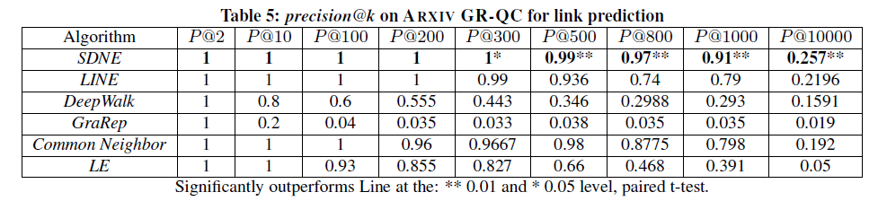
Task3: Link Prediction
Tasks
Results and Discussion
Learn network representations
predict the future links
(nearest neighbor)
the precision keeps at least 0.9
improve at least 15%

Slide 45
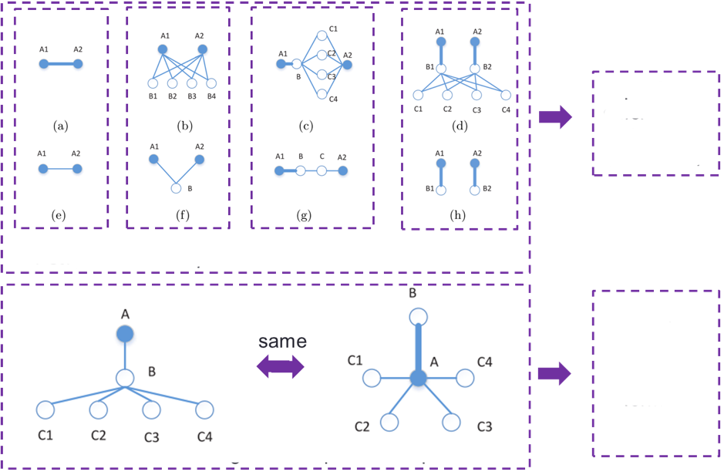
GraRep
capturing
different
k-step
information
1-step 2-step 3-step 4-step
maintaining
different
k-step
information
separately
Do not distinguish 1-step and 2-step
Shaosheng Cao et al. GraRep: Learning Graph Representations with Global Structural Information. CIKM 2015.

Slide 46
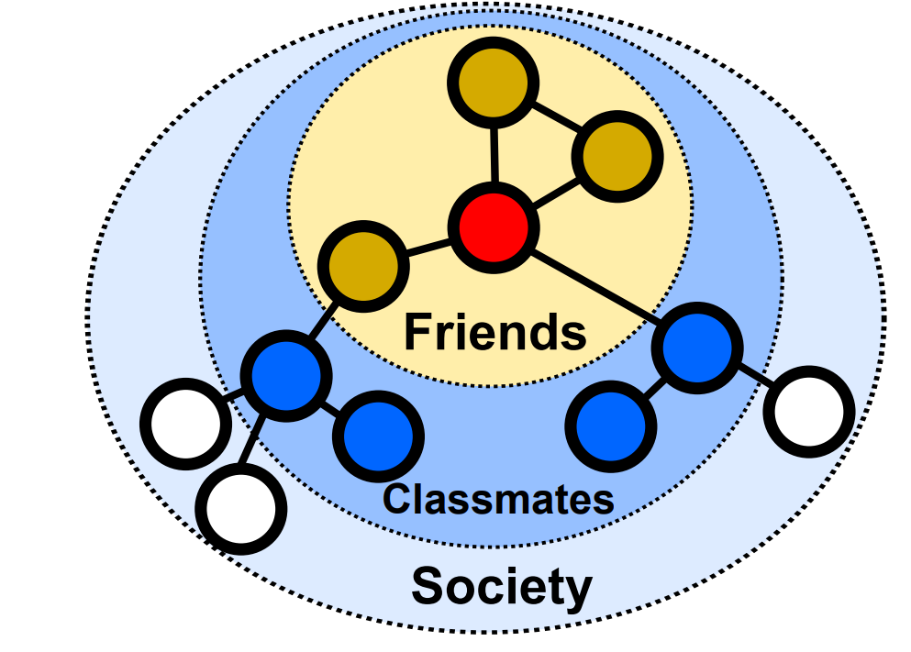
Different High-Order Proximities
Different networks/tasks require different high-order proximities
E.g., multi-scale classification (Bryan Perozzi, et al, 2017)
E.g., networks with different scales and sparsity
Proximities of different orders can also be arbitrarily weighted
E.g., equal weights, exponentially decayed weights (Katz)

Slide 47
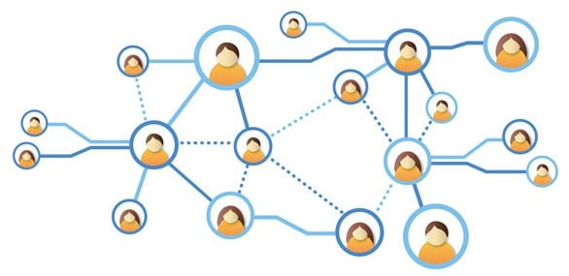


Different High-Order Proximities (cont.)
Existing methods can only preserve one fixed high-order proximity
Different high-order proximities are calculated separately
-> How to preserve arbitrary-order proximity while guaranteeing accuracy and efficiency?
Proximity1
……
Proximity2
Proximity3
Proximity4
Time consuming!
Embedding1
Embedding2
Embedding3
Embedding4

Slide 48
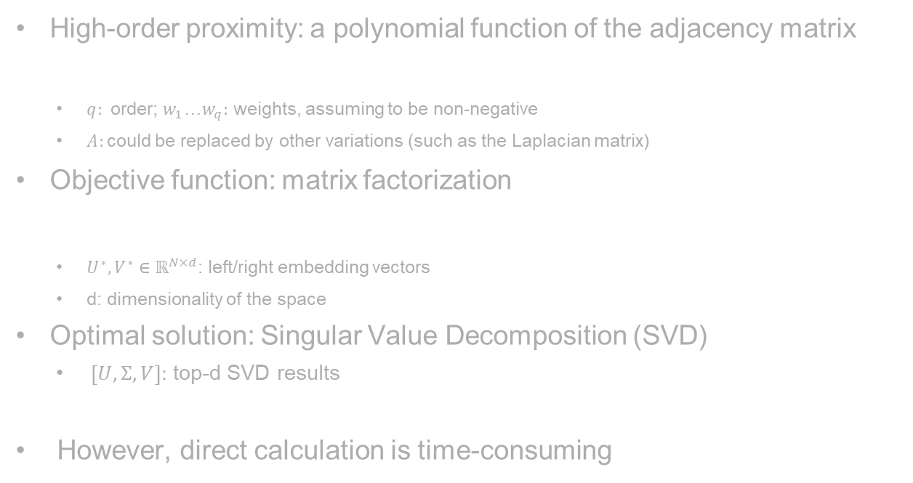
Problem Formulation
High-order proximity: a polynomial function of the adjacency matrix
$$S=f\left(A\right)=w_{1}A^{1}+w_{2}A^{2}+…+w_{q}A^{q}$$
$q:$ order; $w_{1}$…$w_{q}:$ weights, assuming to be non-negative
$A:$could be replaced by other variations (such as the Laplacian matrix)
Objective function: matrix factorization
$$\min_{U^{∗},V^{∗}}{{\left\|S−U^{∗}{V^{∗}}^{T}\right\|}_{F}^{2}}$$
$U^{∗},V^{∗}∈ℝ^{N×d}$: left/right embedding vectors
d: dimensionality of the space
Optimal solution: Singular Value Decomposition (SVD)
$\left[U,Σ,V\right]:$ top-d SVD results
$$U^{∗}=U\sqrt{Σ}, V^{∗}=V\sqrt{Σ}$$
However, direct calculation is time-consuming
Z. Zhang, et al. Arbitrary-Order Proximity Preserved Network Embedding. KDD, 2018.

Slide 49
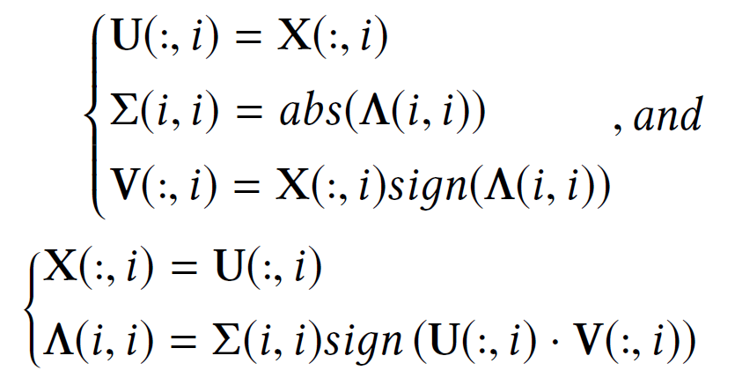
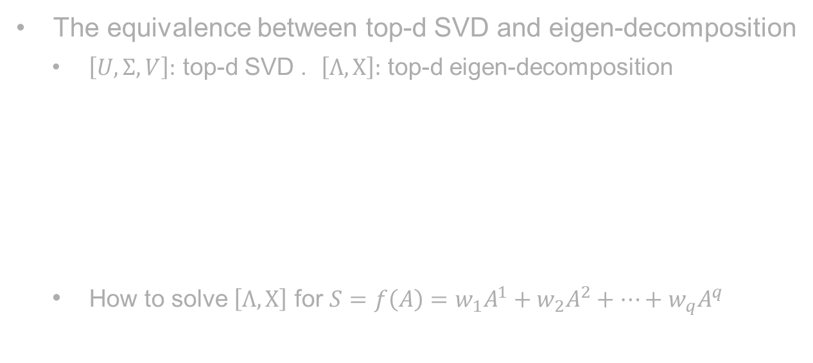
Problem Transformation
The equivalence between top-d SVD and eigen-decomposition
$\left[U,Σ,V\right]:$ top-d SVD . $\left[Λ,X\right]:$ top-d eigen-decomposition
How to solve $\left[Λ,X\right]$ for $S=f\left(A\right)=w_{1}A^{1}+w_{2}A^{2}+…+w_{q}A^{q}$
Z. Zhang, et al. Arbitrary-Order Proximity Preserved Network Embedding. KDD, 2018.

Slide 50
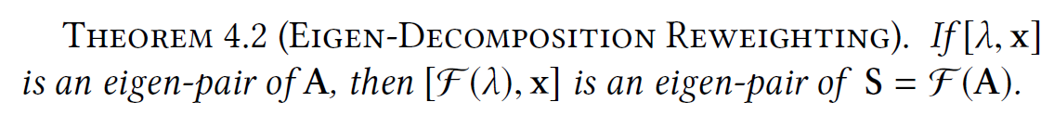




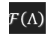




Eigen-decomposition Reweighting
Eigen-decomposition reweighting
Insights: high-order proximity is simply re-weighting dimensions!
Efficient!
$$A$$
Eigen-decomposition
$$X$$
$$Λ$$
Time Consuming!
Polynomial $ℱ\left(·\right)$
Efficient!
Polynomial $ℱ\left(·\right)$
$$S$$
$$X$$
Eigen-decomposition
$$ℱ\left(Λ\right)$$
Time Consuming!
$$U^{∗}=U\sqrt{Σ}, V^{∗}=V\sqrt{Σ}$$
Z. Zhang, et al. Arbitrary-Order Proximity Preserved Network Embedding. KDD, 2018.

Slide 51
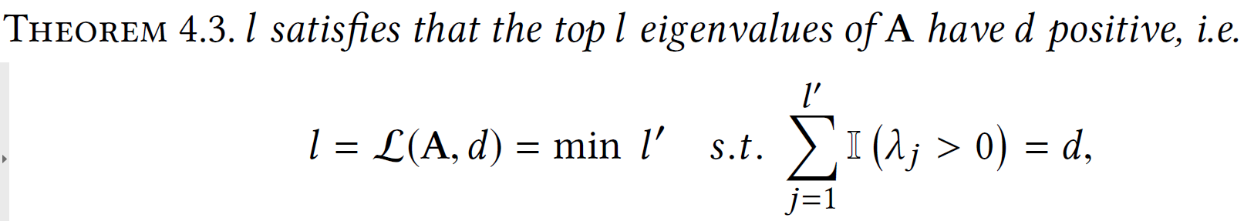
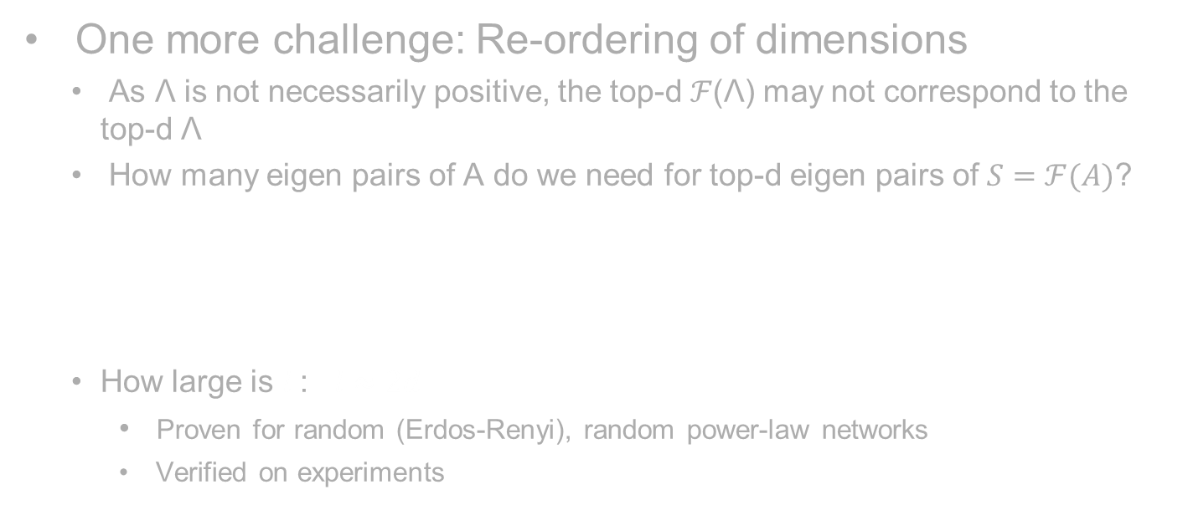
Eigen-decomposition Reweighting (cont.)
One more challenge: Re-ordering of dimensions
As Λ is not necessarily positive, the top-d ℱ(Λ) may not correspond to the top-d Λ
How many eigen pairs of A do we need for top-d eigen pairs of $S=ℱ(A)$?
How large is $l$: $l≈2d$
Proven for random (Erdos-Renyi), random power-law networks
Verified on experiments
Z. Zhang, et al. Arbitrary-Order Proximity Preserved Network Embedding. KDD, 2018.

Slide 52





Preserving Arbitrary-Order Proximity
Shifting across different orders/weights:
Preserving arbitrary-order proximity
Low marginal cost
Accurate and efficient
Embedding1
Shifting
Embedding2
Eigen-decomposition
$$X$$
$$Λ$$
Embedding3
Embedding4
Efficient!
……
Z. Zhang, et al. Arbitrary-Order Proximity Preserved Network Embedding. KDD, 2018.

Slide 53
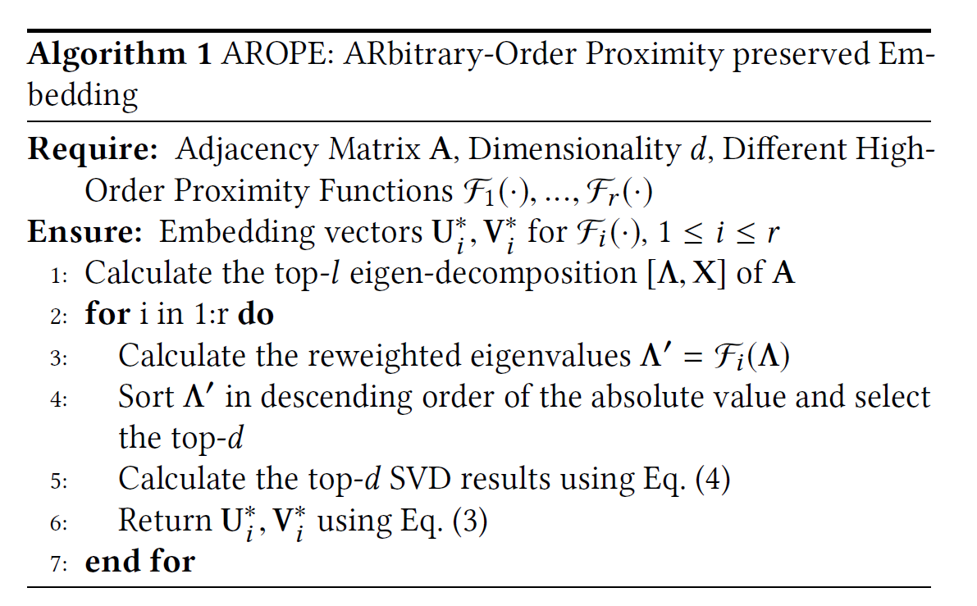

Algorithm Framework
Time complexity: $O\left(T\left(Nl^{2}+Ml\right)+r\left(l+Nd\right)\right)$
$N$: number of nodes; $M$: number of edges; $T$: iteration; $d$: embedding dimension ($l≈2d$); $r$: number of shifting
Linear w.r.t. the network size
Marginal cost of shifting across orders/weights
Z. Zhang, et al. Arbitrary-Order Proximity Preserved Network Embedding. KDD, 2018.

Slide 54

Experimental Results
Preserving the High-Order Proximity
Achieves the optimal solution while being extremely efficient
Z. Zhang, et al. Arbitrary-Order Proximity Preserved Network Embedding. KDD, 2018.

Slide 55

Experimental Results
Link Prediction
+100%
+200%

Slide 56
Network Structures
Nodes & Links
Node Neighborhood
Pair-wise Proximity
Community Structures
Hyper Edges
Global Structure

Slide 57

Community-preserving: M-NMF
first-order
proximity
second-order
proximity
Network structure
Microscopic structure
Pairwise structure: first-order and second-order proximities
Mesoscopic structure
community
structure
Community structure: proximities among a group
important features of network: reveal organizational structure
higher level structural constraints on node representations
Xiao Wang et al. Community Preserving Network Embedding. AAAI, 2017.

Slide 58

Community-preserving: M-NMF
Modularized NMF
Preserving the first and second order proximity
Identifying the community structure
Linking up the node embedding with the community structure
Xiao Wang et al. Community Preserving Network Embedding. AAAI, 2017.

Slide 59

Community-preserving: M-NMF
Evaluation – node clustering
achieve the best results on eight of nine networks
consistently show better performance than M-NMF0
Xiao Wang et al. Community Preserving Network Embedding. AAAI, 2017.

Slide 60
Network Structures
Nodes & Links
Node Neighborhood
Pair-wise Proximity
Community Structures
Hyper Edges
Global Structure

Slide 61
















Hyper-network embedding
$$e_{1}$$
$$e_{2}$$
$$A_{2}$$
$$A_{2}$$
$$L_{2}$$
$$U_{2}$$
$$L_{2}$$
$$U_{2}$$
$$L_{1}$$
$$L_{1}$$
$$A_{1}$$
$$A_{1}$$
$$U_{1}$$
$$U_{1}$$
$$e_{3}$$
$$e_{4}$$
Networks
Hyper-Networks
A hyper-network is a network in which an edge can include any number of nodes
Notes:
This leads to hyper-network. A hyper-network is a network in which an edge can join any number of nodes. For example, in co-author network, a paper may have more than two authors. Then How to learn representations in such a hyper-network?

Slide 62





































Naïve solution: Expand into Conventional Networks
$$e_{1}$$
$$e_{2}$$
$$A_{2}$$
$$A_{2}$$
$$U_{2}$$
…
$$A_{1}$$
$$A_{1}$$
$$U_{1}$$
$$A_{2}$$
$$(b)$$
$$U_{2}$$
$$L_{1}$$
$$L_{1}$$
$$U_{1}$$
$$L_{2}$$
$$L_{2}$$
$$L_{2}$$
$$U_{2}$$
explicit similarity
$$L_{1}$$
$$A_{1}$$
$$(c)$$
$$U_{1}$$
$$e_{1}$$
$$e_{1}$$
$$e_{1}$$
$$e_{4}$$
$$e_{4}$$
$$e_{4}$$
…
$$e_{3}$$
$$e_{4}$$
$$A_{2}$$
$$U_{2}$$
$$L_{1}$$
$$A_{1}$$
$$U_{1}$$
$$L_{2}$$
$$(a)$$
implicit similarity
(a) A hyper-network (b) The clique expansion. (c) The star expansion
We usually assume that the hyper-edges are decomposable.
Notes:
A naïve solution is to expand the hyper-network into conventional pairwise networks and then apply the embedding methods which are developed on pairwise networks. These expansions assume that the hyperedges are decomposable. That is to say, if we treat a hyperedge as a set of nodes, then any subset of nodes in this hyperedge can form another hyperedge.

Slide 63












Hyper-edges are often indecomposable
reaction
Person
paper
venue
Drug
Author 1
Author 3
Author 2
Adverse Drug Network
Bibliographic Network
Ke Tu, et al. Structural Deep Embedding for Hyper-Networks. AAAI, 2018.
Notes:
However, This assumption is not always reasonable, especially in complex heterogeneous hyper-network. For example, in the adverse drug [drʌg] network with <person, drug, reaction> relationships, a user who has certain reaction and takes some drugs will lead to adverse event. But <person, reaction> relationships are not typically strong.

Slide 64














Challenges
$$e_{1}$$
$$e_{2}$$
$$A_{2}$$
$$A_{2}$$
$$U_{2}$$
$$L_{1}$$
$$L_{2}$$
$$U_{2}$$
$$L_{2}$$
$$A_{2}$$
$$U_{2}$$
$$L_{1}$$
…
$$A_{1}$$
Indecomposable edge
$$U_{1}$$
$$L_{2}$$
$$A_{1}$$
$$U_{1}$$
$$e_{3}$$
$$e_{4}$$
How to preserve the indecomposable relationships while learning representations?
How to preserve structures for sparse hyper-networks?
Notes:
Therefore how to preserve the indecomposable relationships while learning representations is a big challenge of this problem. Besides, the hyper-network is usually incomplete and sparse, it not sufficient for preserving hyper-network structure only using the observed relationships. We need to deal with the sparsity issue and the indecomposablity issue at the same time.

Slide 65


N-tuplewise similarity requires non-linear model
Preserve N-tuplewise similarity in embedding space
We use deep neural network to solve this non-linear problem.
Ke Tu, et al. Structural Deep Embedding for Hyper-Networks. AAAI, 2018.
Notes:
To preserve the first-order proximity of a hyper-network in embedding space, an N-tuplewise similarity measure in embedding space is required. However, unlike inner product distance or Euclidean distance measures pairwise similarity in vector space, there is no well-accepted N-tuplewise similarity function. In our model, we propose a data-dependent N-tuplewise similarity function S. To preserve consistency of first-order proximity in origin hyper-network and embedding space, the similarity function S should satisfy the following property. If N nodes forms a hyper-edge, the tuple-wise similarity among them will be large otherwise small. Here we provide the theorem to demonstrate that a linear tuplewise similarity function cannot satisfy the Property. You can see the proof in our paper if interest. Due to the powerful representation ability of deep learning, we design a deep neural network to solve this non-linear problem.

Slide 66








First- and second-order proximities
$$e_{1}$$
$$e_{2}$$
Node $A−B−C$
first-order proximity
$$A$$
$$B$$
Node $C−D$
second-order proximity
$$C$$
$$D$$
The first-order proximity of hyper-network measures the N-tuplewise similarity between nodes
The second-order proximity of hyper-network measures the proximity of two nodes with respect to their neighborhood structures.
Ke Tu, et al. Structural Deep Embedding for Hyper-Networks. AAAI, 2018.
Notes:
A good representations of hyper-network should solve the indecomposablity issue and the sparsity issue. For indecomposablity issue, we define the first-order proximity . The first-order proximity of hyper-network measures the indecomposable similarity between nodes. For example, nodes (A, B, C) and (A, B, D) in the graph. due to the sparsity of networks, many existing relationships are not observed. It is not sufficient for preserving hyper-network structure with only first-order proximity. And global structures, e.g. the neighborhood structure, are required to address the sparsity problem. For the purpose , we define the second-order proximity of hyper-network as the proximity of two nodes with respect to their neighborhood structures. Two nodes with similar neighborhoods should have large second-order proximity. For example, nodes (C, D) in the graph.

Slide 67




Structural Deep Network for Hyper-network
Unsupervised Heterogeneous Component
Node Type a
Node Type b
Node Type c
$$A_{i}^{a}, A_{j}^{b}, A_{k}^{c}$$
…
…
…
.
second-order preserving
First Layer
autoencoder
autoencoder
autoencoder
$$X_{i}^{a}, X_{j}^{b}, X_{k}^{c}$$
…
…
…
Second Layer
Non-linear mapping
$$L_{ijk}$$
……
Third Layer
tuple-wise similarity function
first order preserving
$$S_{ijk}$$
+1
-1
Supervised Binary Component
Ke Tu, et al. Structural Deep Embedding for Hyper-Networks. AAAI, 2018.
Notes:
Here is the whole framework of our model. It can be divided into two part. First, we design a deep autoencoder to learn node representations by reconstructing neighborhood structures, ensuring that the nodes with similar neighborhood structures will have similar embeddings. Then the embeddings can preserve second-order proximity. After that, an indecomposable tuplewise similarity function is builded by a multi-layer perceptron to measure the tuplewise similarity of the embeddings of N nodes. By predicting whether the hyper-edge exists among the N nodes, the first-order proximity is preserved. Now we will tell how this model works in detail.

Slide 68

Time Complexity Analysis
The time complexity of training process is $O((nd + dl + l)bI)$
$n$ is the number of nodes
$d$ is the dimension of embedding vectors, set as 16, 32, 64, 128
$l$ is the size of latent layer, set as $3d$
$b$ is the batch size
$I$ is the number of iterations(epochs), set as 10
Conclusion: the complexity of training process is linear to the number of nodes $n$.
Ke Tu, et al. Structural Deep Embedding for Hyper-Networks. AAAI, 2018.
Notes:
The time complexity of traning is shown in the slide where n is the number of nodes and d is …, l is …, b is **, I is **. It is easy to see that the complexity of training procedure is linear to the number of nodes $n$ and can scale to large networks.

Slide 69


Experiment: link prediction
~14%
the overall performance
Performance on networks of different sparsity
Ke Tu, et al. Structural Deep Embedding for Hyper-Networks. AAAI, 2018.
Notes:
The second-task is link prediction. We fulfil two link prediction tasks. The two tasks evaluate the overall performance and the performance with different sparsity of the networks respectively. For the first task, we randomly hide 20 percentage of existing edges and use the left network to train hyper-network embedding models. In left table, we can see our method achieves significant improvements over the baselines on all the datasets. For the second task, we change the sparsity of network by randomly hiding different ratios of existing edges and repeat the previous task. We can see our method is robust on sparse network.

Slide 70
Network Structures
Nodes & Links
Node Neighborhood
Pair-wise Proximity
Community Structures
Hyper Edges
Global Structure

Slide 71
Motivation
Vertexes in different parts of the network may have similar roles (global position)
Example：
Managers in the social network of a company
Outliers in a network in the task of anomaly detection
Social network with different position
How to reflect the role or importance of a vertex in embedding space?

Slide 72
Existing embedding methods – local structure
3
5
1
7
8
2
4
6
They can only preserve local proximity(Structural equivalence), can not reflect the global position
Embeddings of node 5,6 in left network will be similar but embeddings of node 1, 2 in right network will not be similar.

Slide 73


Regular Equivalence
Two nodes are regularly equivalent if their network neighbors are themselves similar (i.e. regularly equivalent).
3
4
1
5
3
1
7
5
8
2
2
4
6
6
Structural equivalence $s$
$N(u) = N(v)$
Direct way
Common neighbors
Regular equivalence $r$
$\left\{r \left(i\right) | i ∈ N\left(u\right)\right\}= \left\{r \left(j\right) | j ∈ N\left(v\right)\right\}$
Recursive way
Similar global position
Regular equivalence is largely ignored in network embedding

Slide 74

Deep Recursive Network Embedding
The definition of regular equivalence is recursive
Aggregating neighbors’ information in a recursive way
How to design the aggregating function
Variable length of neighbors
Highly nonlinear
→ Layer-normalized LSTM
Ke Tu, et al. Deep Recursive Network Embedding with Regular Equivalence. KDD, 2018.

Slide 75






Deep Recursive Network Embedding
reconstruct
6
7
$$X_{0}$$
$$h_{T}$$
0
3
1
2
5
1
LN
LN
LN
3
9
8
MLP
0
LSTM
LSTM
LSTM
$$d_{0}$$
2
4
1
7
4
3
2
8
5
6
$$X_{3}$$
$$X_{1}$$
$$X_{2}$$
8
9
3
1
2
(a)
(b)
(c)
(d)
(a) Sampling neighborhoods
(b) Sorting neighborhoods by their degree
(c) aggregate neighbors
(d) A Weakly guided regularizer
Ke Tu, et al. Deep Recursive Network Embedding with Regular Equivalence. KDD, 2018.

Slide 76


Theoretical Analysis
Ke Tu, et al. Deep Recursive Network Embedding with Regular Equivalence. KDD, 2018.

Slide 77

Experiment --- Network Visualization

Slide 78


Experiment --- predict centrality
The MSE value of predicting centralities on Jazz dataset (∗10−2)
The MSE value of predicting centralities on BlogCatalog dataset (∗10−2)
Ke Tu, et al. Deep Recursive Network Embedding with Regular Equivalence. KDD, 2018.

Slide 79

Experiment --- Structural Role Classification
Europe air-traffic
American air-traffic
Ke Tu, et al. Deep Recursive Network Embedding with Regular Equivalence. KDD, 2018.

Slide 80
Section Summary
Nodes & Links
Node Neighborhood
Network Characteristics
Pair-wise Proximity
Community Structures
Application Characteristics
Hyper Edges
Global Structure

Slide 81
Outline
Structure-preserved network embedding
Property-preserved network embedding
Dynamic network embedding

Slide 82
Why preserve network properties?
Heterogeneity
Notes:
Next, let’s come to the second problem, maintain network properties, especially, transitivity.
In networks, transitivity is ubiquitous. If A and B have a link, B and C have a link, then it’s possible that A and C also have a link.
At the same time, the transitivity phenomenon also exists in the embedding space, that is guaranteed by the triangle inequality. If A is close to b, and B is close to C, then A will be relatively close to C.
It seems that these two sides perfectly match. However, real network data is complex than we assumed.

Slide 83


Two important network properties
Transitivity
Uncertainty
Notes:
Next, let’s come to the second problem, maintain network properties, especially, transitivity.
In networks, transitivity is ubiquitous. If A and B have a link, B and C have a link, then it’s possible that A and C also have a link.
At the same time, the transitivity phenomenon also exists in the embedding space, that is guaranteed by the triangle inequality. If A is close to b, and B is close to C, then A will be relatively close to C.
It seems that these two sides perfectly match. However, real network data is complex than we assumed.

Slide 84

Transitivity
The Transitivity Phenomenon
Network
Embedding Space
B
Triangle Inequality:
$$D\left(A,B\right)+D\left(B,C\right)>D(A,C)$$
A close to B, B close to C, → A relatively close to C
A
C
However, real network data is complex…
Notes:
Next, let’s come to the second problem, maintain network properties, especially, transitivity.
In networks, transitivity is ubiquitous. If A and B have a link, B and C have a link, then it’s possible that A and C also have a link.
At the same time, the transitivity phenomenon also exists in the embedding space, that is guaranteed by the triangle inequality. If A is close to b, and B is close to C, then A will be relatively close to C.
It seems that these two sides perfectly match. However, real network data is complex than we assumed.

Slide 85




Non-transitivity
The Co-existence of Transitivity and Non-transitivity
Image network
Social network
A
dog
lawn
Collegue
Classmate
B
cat
lawn
Word network
C
cat
floor
Apple
Cellphone
Banana
How to incorporate non-transitivity in embedding space?
Notes:
The first challenge is non-transitivity. Real-world networks do not often come with the transitivity. For example, in image network, image A is similar with image B because they all have the same background of lawn. Image B is similar with Image C because they all have a cat. However, Image A is not similar with image C at all. Similarly, in Word network, Apple is similar with Cellphone and Banana, but cellphone and banana are never similar. Therefore, it rises a question how to incorporate non-transif

Slide 86


Asymmetric Transitivity
Directed Network
A→B, B → C => A → C, but not C →A
B
Forward
Backward
Forward Transitive
A
C
Backward Transitive
Tencent Microblog
Twitter
Distance metric in embedding space is symmetric.
How to incorporate Asymmetric Transitivity?
Notes:
The second challenge is asymmetric transitivity. We know that in directed networks, the transitivity is asymmetric. For example, if A has a link to B, and B has a link to C, then A is possible to have a link to C, while the probability of C having a link to A is lower. We also observe that the asymmetric transitivity do exists in real data, and play important roles for link formation. The problem is the distance metric in embedding space is symmetric. How to incorporate asymmetric transitivity into the symmetric embedding space?

Slide 87









Non-transitivity
The source of non-transitivity:
Each node has multiple similarity components
Non-transitive
Transitive
Transitive
A
dog
lawn
Object SC
Scene SC
A1
dog
A2
lawn
B
cat
lawn
B1
cat
B2
lawn
C
cat
floor
C1
cat
C2
floor
Non-transitive Embedding: represent non-transitive data
with multiple latent similarity components
M. Ou, et al. Non-transitive Hashing with Latent Similarity Components. KDD, 2015.
Notes:
Let’s first look at the problem of non-transitivity. To solve the problem, we need to first find the origin of it. The reason why it causes the non-transitivity is that each node has multiple similarity components. Back to the previous examples, B and C are similar in terms of the objects component, A and B are similar in terms of the scene components. But A and C will not be similar in both of these two components. Therefore, they will not be regarded as similar. Therefore, it motivates us to represent non-transitive data with multiple latent similarity components when we perform network embedding.

Slide 88
Asymmetric Transitivity
All existing methods fail..
Single Vector
A
A
B
“Asymmetric” fail
C
B
Double Vectors
Source
Target
C
A
B
“Transitivity” fail
C
Notes:
For the second problem of asymmetric transitivity, there is no sound solution in literature.
In this example, if we give each node a single vector, then A and B is similar, B and C is similar, and A and C will be similar in both directions. So asymmetric will fail.
If we give each node two vectors, then source A is similar to target B, source B will be similar to target C. As there is no constraint on source A and target C, then they are not necessarily similar. So transitivity will fail.
Those said, asymmetric transitivity is still an open problem.

Slide 89

Asymmetric Transitivity
Inspired by high-order proximities
High-order proximities are asymmetric transitivity metrics
Katz Similarity: weighted sum of paths between two nodes, where the weights decrease with the path length increasing.
$$S_{katz}=\sum_{i=1}^{+∞}{{(beta∗A )}^{i}}$$
B
Source
Target
C
0.3
0.3
A
0.18
C
B
0
A
Notes:
Through extensive study, we found that high-order proximities are adequate asymmetric transitivity metrics.
Let’s take Katz similarity as an example. The similarity from A to B is .3, the similarity from B to C is .3, and the similarity from A to C is .18, but the similarity from C to A is 0. These results are totally coincide with our requirements for asymmetric transitivity.

Slide 90

Asymmetric Transitivity
A straightforward solution
High-order proximity matrix
Source embedding
matrix
Target embedding
matrix
However, the calculation of high-order proximities is not scalable. ($O(N^{3})$ for Katz)
Mingdong Ou, et al. Asymmetric Transitivity Preserving Graph Embedding. KDD, 2016.
Notes:
Then a straightforward solution might be SVD. The difference with traditional methods is to replace the adjacency matrix with the high-order proximity matrix. However, the problem is not that easy, because the calculation of high-order proximities is not scalable. For example, the time complexity for calculating Katz is N cube. How can we calculate it in a billion-scale network?

Slide 91
Asymmetric Transitivity
The general formulation of high-order proximities
Mingdong Ou, et al. Asymmetric Transitivity Preserving Graph Embedding. KDD, 2016.
Notes:
Fortunately, we find that all the typical high-order proximities share a same general form. All of them can be transformed into the product of a inverse matrix with another matrix. And these two matrices are polynomial of adjacency matrix or its variants

Slide 92
Asymmetric Transitivity
Decompose S without calculating S – Generalized SVD
Mingdong Ou, et al. Asymmetric Transitivity Preserving Graph Embedding. KDD, 2016.
Notes:
With this general form, we can decompose matrix S without really calculating S, with the mathematic tool of generalized SVD. Specifically, we can use an iterative approach to solve this problem

Slide 93

Asymmetric Transitivity
Linear Complexity
JDGSVD: Time Complexity
$$O\left(K^{2}L⋅m\right)$$
Embedding Dimension Iteration Edge number
(constant) (constant)
Linear complexity w.r.t. the volume of data (i.e. edge number)
--> Scalable algorithm, suitable for large-scale data
Mingdong Ou, et al. Asymmetric Transitivity Preserving Graph Embedding. KDD, 2016.
Notes:
The complexity of the solution is linear with the number of edges in the network

Slide 94

Experiment result: Link Prediction
Conclusion: HOPE has good inference ability
-> based on asymmetric transitivity
+100%
+100%
Mingdong Ou, et al. Asymmetric Transitivity Preserving Graph Embedding. KDD, 2016.
Notes:
Low-rank space.

Slide 95

Experiment result: Vertex Recommendation
Conclusion: HOPE significantly outperforms all state-of-the-art baselines on all these experiments
+88% improvement
+81% improvement
Mingdong Ou, et al. Asymmetric Transitivity Preserving Graph Embedding. KDD, 2016.

Slide 96

Uncertainties in Networks
The formation and evolution of real-world networks are full of uncertainties
E.g., for the nodes with low degree, they contain less information and thus their representations bear more uncertainties than others.
E.g., for the nodes across multiple communities, the possible contradiction between their neighboring nodes may also be large and thus cause the uncertainty.

Slide 97

Uncertainties in Networks
Learning an embedding as a distribution rather than a point-vector allows us to capture uncertainty of the nodes
The mean vectors reflect the position of the nodes and variance terms should contain the uncertainty of the nodes.
Gaussian distribution innately represents the uncertainty property[1].
[1] Luke Vilnis and Andrew McCallum. 2014. Word representations via Gaussian embedding. arXiv preprint arXiv:1412.6623 (2014).

Slide 98

Basic requirements
Structural Proximities
Transitivity
Uncertainty
The mean vectors should reflect the position of the nodes.
The variance terms should contain the uncertainty of the nodes.

Slide 99


Learning Embedding in Wasserstein Space
Wasserstein Distance for Transitivity
Measure the similarity between two distributions
Satisfies the triangle inequality
The p^{th} Wasserstein distance between two probability measures μ and ν is defined as:
The 2nd Wasserstein distance has the closed form solution for Gaussian distribution:
When covariance matrix is diagonal, the time complexity of calculating W₂ distance is linear with the embedding dimension L :

Slide 100

DVNE for Structure and Uncertainty
Dingyuan Zhu, et al. Deep Variational Network Embedding in Wasserstein Space. KDD, 2018.

Slide 101



Experimental Results
Network Reconstruction & Link Prediction
Multi-label Classification

Slide 102

Experimental Results
Uncertainty
Dingyuan Zhu, et al. Deep Variational Network Embedding in Wasserstein Space. KDD, 2018.

Slide 103
Section Summary
Compared with network structures, network properties have large space to explore in network embedding.
Transitivity is important for network inference.
Uncertainty provides evidence in making network inference.
Many other property issues:
The right embedding space: Euclidean space?
Power-law distribution
…

Slide 104
Outline
Structure-preserved network embedding
Property-preserved network embedding
Dynamic network embedding

Slide 105

Dynamic Networks
Networks are dynamic in nature
New (old) nodes are added (deleted)
New users, products, etc.
The edges between nodes evolve over time
Users add or delete friends in social networks, or neurons establish new connections in brain networks.
How to efficiently incorporate the dynamic changes when networks evolve?

Slide 106
Key problems in dynamic network embedding
I : Out-of-sample nodes
II : Incremental edges
III: Aggregated error
IV: Scalable optimization

Slide 107
Challenge: High-order Proximity
High-order proximity
Critical structural property of networks
Measure indirect relationship between nodes
Capture the structure of networks with different scales and sparsity
Network Embedding V.S. Traditional Graph Embedding

Slide 108
Challenge: High-order Proximity
I : Out-of-sample nodes
II : Incremental edges
III: Aggregated error
IV: Scalable optimization
Preserve High-order Proximities
Local Change leads to Global Updating

Slide 109
Key problems in dynamic network embedding
I : Out-of-sample nodes
II : Incremental edges
III: Aggregated error
IV: Scalable optimization

Slide 110


Problem
To infer embeddings for out-of-sample nodes.
G=(V, E) evolves into G’=(V’, E’), where V’ = V $∪$V*.
n old nodes: V = {v1,…,vn}, m new nodes: V* = {vn+1,…,vn+m}
Network embedding: f: V$→$Rd
We know f(v) for old nodes, want to infer f(v) for new nodes.

Slide 111
Challenges
Preserve network structures
e.g. high-order proximity
need to incorporate prior knowledge on networks
Share similar characteristics with in-sample embeddings
e.g. magnitude, mean, variance
requires a model with great expressive power to fit the data well
Low computational cost
Jianxin Ma, et al. DepthLGP: Learning Embeddings of Out-of-Sample Nodes in Dynamic Networks. AAAI, 2018.

Slide 112
Specific vs. General
Specific
A new NE algorithm capable of handling OOS nodes.
General
A solution that helps an arbitrary NE algorithm handle OOS nodes.
We propose a general solution.
But it can be easily integrated into an existing NE algorithm (e.g. DeepWalk) to derive a specific algorithm (see the paper).
Jianxin Ma, et al. DepthLGP: Learning Embeddings of Out-of-Sample Nodes in Dynamic Networks. AAAI, 2018.
Notes:
TODO: What’s the motivation of proposing a general solution. (Don’t know how to fix this anyway.)

Slide 113

DepthLGP
Network embedding: f: V$→$R^{d}
Problem: Hard to model f directly, due to nonlinearity.
Solution: Let f be nonlinearly transformed from a simpler space.
A latent function easier to model: h: V$→$R^{s}
Model each h_{k}: V$→$R with a Gaussian process (h(v) = [h₁(v),…,h_{s}(v)]).
Advantages: Easy to encode network properties in the kernel of a GP; GPs naturally provide high-quality generalization on unseen nodes.
A deep neural network: g: R^{s}$→$R^{d}
Nonlinear transformation: f(v)=g(h(v))
Jianxin Ma, et al. DepthLGP: Learning Embeddings of Out-of-Sample Nodes in Dynamic Networks. AAAI, 2018.

Slide 114

DepthLGP
Nonparametric probabilistic modeling + Deep Learning
Jianxin Ma, et al. DepthLGP: Learning Embeddings of Out-of-Sample Nodes in Dynamic Networks. AAAI, 2018.

Slide 115


DepthLGP
Design a kernel for the kth (k=1,…,s) dimension of h($∙$)
First-order Proximity
Second-order Proximity
Node Weights
(to prune uninformative nodes)
¹The matrix inversion can be bypassed without approximation.
²a^{(k)}_{v} indicates how much attention we pay to a node. It is learned for an in-sample node, but fixed to one for an OOS node, as we are always interested in OOS nodes.

Slide 116

Theories
The model can fit arbitrary network embedding.
There exists such a set of parameters that: …
Jianxin Ma, et al. DepthLGP: Learning Embeddings of Out-of-Sample Nodes in Dynamic Networks. AAAI, 2018.

Slide 117

Task I: Classification
Jianxin Ma, et al. DepthLGP: Learning Embeddings of Out-of-Sample Nodes in Dynamic Networks. AAAI, 2018.

Slide 118

Task II: Link Prediction
Jianxin Ma, et al. DepthLGP: Learning Embeddings of Out-of-Sample Nodes in Dynamic Networks. AAAI, 2018.

Slide 119
Key problems in dynamic network embedding
I : Out-of-sample nodes
II : Incremental edges
III: Aggregated error
IV: Scalable optimization

Slide 120

The Static Model
We aim to preserve high-order proximity in the embedding matrix with the following objective function：
where S denotes the high-order proximity matrix of the network
U and U’ is the results of matrix decomposition of S.
For undirected networks, U and U’ are highly correlated.
Without loss of generality, we choose U as the embedding matrix.
Dingyuan Zhu, et al. High-order Proximity Preserved Embedding For Dynamic Networks. IEEE TKDE, 2018.

Slide 121

GSVD
We choose Katz Index as S because it is one of the most widely used measures of high-order proximity.
where β is a decay parameter, I is the identity matrix and A is the adjacency matrix
According to HOPE[1], the original objective function can be solved by the generalized SVD (GSVD) method
Mingdong Ou,et al. Asymmetric Transitivity Preserving Graph Embedding. KDD, 2016.
Notes:
[1] HOPE, M. Ou, et al. KDD 2016.

Slide 122
Problem Transformation
For static model, we get the GSVD results of the high-order proximity matrix as the embedding of nodes.
But it is difficult to incremental updating the GSVD results directly.
Here we propose to transform the GSVD problem into generalized eigenvalue problem, so that the incremental updating is feasible.
Dingyuan Zhu, et al. High-order Proximity Preserved Embedding For Dynamic Networks. IEEE TKDE, 2018.

Slide 123

GSVD → Generalized Eigen Problem
Formally, GSVD can be transformed into the generalized eigenvalue problem as:
where λ_{i} are the eigenvalues of S in descending order, and X is a matrix which contains the corresponding eigenvectors of λ_{i} and sgn() is the Sign function.
Dingyuan Zhu, et al. High-order Proximity Preserved Embedding For Dynamic Networks. IEEE TKDE, 2018.

Slide 124

Generalized Eigen Perturbation
We propose generalized eigen perturbation to fulfill the task.
The goal of generalized eigen perturbation is to update X^{(t)} to X^{(t+1)}
Specifically, given the change of adjacency matrix △A between two consecutive time steps, the change of Ma and Mb can be represented as:
Dingyuan Zhu, et al. High-order Proximity Preserved Embedding For Dynamic Networks. IEEE TKDE, 2018.

Slide 125


Experiments
Link prediction
Node Classification

Slide 126
Key problems in dynamic network embedding
I : Out-of-sample nodes
II : Incremental edges
III: Aggregated error
IV: Scalable optimization

Slide 127







Problem: Error Accumulation
Eigen perturbation is at the cost of inducing approximation
A₀
U₀
$$\underset{⇒}{SVD}$$
∑₀
V₀
$$⇒$$
$$Update$$
A₁
U₁’
$$≈$$
∑₁’
V₁’
Error
Accumulation!
…
$$⇒$$
$$Update$$
A_{t}
U_{t}’
$$≈$$
∑_{t}’
V_{t}’
Problem: error accumulation is inevitable

Slide 128




Solution: SVD Restarts
Solution: restart SVD occasionally
A₀
U₀
$$\underset{⇒}{SVD}$$
∑₀
V₀
$$⇒$$
$$Update$$
A₁
U₁’
∑₁’
V₁’
…
A_{t}
U_{t}
Restart
$$\underset{⇒}{SVD}$$
∑_{t}
V_{t}
$$⇒$$
$$Update$$
When?
A_{t+1}
U_{t+1}’
∑_{t+1}’
V_{t+1}’
What are the appropriate time points?
Too early restarts: waste of computation resources
Too late restarts: serious error accumulation

Slide 129


Naïve Solution
Naïve solution: fixed time interval or fixed number of changes
Difficulty: error accumulation is not uniform
Ziwei Zhang, et al. TIMERS: Error-Bounded SVD Restart on Dynamic Networks. AAAI, 2018.

Slide 130


Existing Method
Existing method: monitor loss (Chen and Candan, KDD 2014)
Loss in SVD:
$𝒥={\left\|S−UΣV^{T}\right\|}_{F}^{2}$
$S$: target matrix, $\left[U,Σ,V\right]:$ results of SVD
Problem: loss includes approximation error and intrinsic loss in SVD
Ziwei Zhang, et al. TIMERS: Error-Bounded SVD Restart on Dynamic Networks. AAAI, 2018.

Slide 131


Framework: Monitor Margin
Observation: the margin between the current loss and intrinsic loss in SVD is the actual accumulated error
Current loss: $𝒥={\left\|S−UΣV^{T}\right\|}_{F}^{2}$
Intrinsic loss: $ℒ\left(S,k\right)=\min_{U^{∗},Σ^{∗},V^{∗}}{{\left\|S−U^{∗}Σ^{∗}{V^{∗}}^{T}\right\|}_{F}^{2}},k:dimensionality$
Ziwei Zhang, et al. TIMERS: Error-Bounded SVD Restart on Dynamic Networks. AAAI, 2018.

Slide 132



Framework: Monitor Margin
Framework: monitor the maximum margin
Formulation: constrained optimization
$c_{t}:$ whether to restart; $𝒢:$ evaluating the margin; $Θ:$ threshold
Intuition: keep the maximum margin within a threshold while reducing the number of restarts
Ziwei Zhang, et al. TIMERS: Error-Bounded SVD Restart on Dynamic Networks. AAAI, 2018.

Slide 133

Solution: Lazy Restarts
Lazy restarts: restart only when the margin exceeds the threshold
Problem: intrinsic loss is hard to compute
Direct calculation has the same time complexity as SVD
Relaxation: an upper bound on margin
A lower bound on intrinsic loss ℒ(𝑆,𝑘)
𝒥(𝑡): current loss; ℒ(𝑆_𝑡,𝑘): intrinsic loss; 𝐵(𝑡): bound of intrinsic loss
Ziwei Zhang, et al. TIMERS: Error-Bounded SVD Restart on Dynamic Networks. AAAI, 2018.

Slide 134

A Lower Bound of SVD Intrinsic Loss
Idea: use matrix perturbation
Intuition: treat changes as a perturbation to the original network
Ziwei Zhang, et al. TIMERS: Error-Bounded SVD Restart on Dynamic Networks. AAAI, 2018.

Slide 135


Time Complexity Analysis
Conclusion: the complexity is only linear to the local dynamic changes
Ziwei Zhang, et al. TIMERS: Error-Bounded SVD Restart on Dynamic Networks. AAAI, 2018.

Slide 136


Experimental Results: Approximation Error
Fixing number of restarts
Fixing maximum error
27%~42% Improvement
-50%
Ziwei Zhang, et al. TIMERS: Error-Bounded SVD Restart on Dynamic Networks. AAAI, 2018.

Slide 137


Experimental Results: Analysis
Syntactic networks: simulate drastic changes in the network structure
Robust to sudden changes
Linear scalability

Slide 138
Key problems in dynamic network embedding
I : Out-of-sample nodes
II : Incremental edges
III: Aggregated error
IV: Scalable optimization

Slide 139


Highly-dynamic & Recency-sensitive Data
News recommendation applications: a bipartite graph
WeChat news recommendation network is highly dynamic
81 articles and 1400 reading records per second
The network is also recency-sensitive
>73% articles died less than 6 hours while no one read again
Obvious exponential decay for article duration length.
Xumin Chen, et al. Scalable Optimization for Embedding Highly-Dynamic and Recency-Sensitive Data. KDD, 2018.(Applied)

Slide 140
Limited resources
We cannot guarantee convergence in-between every two timestamps.
Just do it.
How to do better?
Non-uniform resource allocation.
New edges and nodes worth more resources.
Xumin Chen, et al. Scalable Optimization for Embedding Highly-Dynamic and Recency-Sensitive Data. KDD, 2018.(Applied)

Slide 141

Base Optimization Method
Globally Decay: A recency strategy of weight matrix $W^{\left(t\right)}$
$$w_{i,j}^{\left(t+1\right)}=\left\{\begin{matrix}1 & if \left(i,j\right) is the newly added or deleted edge \\ τw_{i,j}^{\left(t\right)} & elsewise\end{matrix}\right.$$
Randomly applies SGD iteration according to $w_{i,j}^{\left(t\right)}$
$$u_{i}^{\left(t\right)}\left(r\right)←u_{i}^{\left(t\right)}\left(r−1\right)−η\frac{∂J^{\left(t\right)}}{∂u_{i}}\left(u_{i}^{\left(t\right)}\left(r−1\right),v_{j}^{\left(t\right)}\left(r−1\right),a_{i,j}^{\left(t\right)}\right)$$
$$v_{i}^{\left(t\right)}\left(r\right)←v_{i}^{\left(t\right)}\left(r−1\right)−η\frac{∂J^{\left(t\right)}}{∂v_{i}}\left(u_{i}^{\left(t\right)}\left(r−1\right),v_{j}^{\left(t\right)}\left(r−1\right),a_{i,j}^{\left(t\right)}\right)$$
Limitations of this method:
Redundant: a new edge will be selected multiple times during two timestamps
Incomplete: existing edges are less likely to be selected

Slide 142


Diffused SGD: Step-wise Weight Diffusion Mechanism
The Change of a node embedding vector depends on its distance to the changed edge.
Diffuse across training steps
For step $r$, if edge $\left(i,j\right)$ is chosen by stochastic method
Xumin Chen, et al. Scalable Optimization for Embedding Highly-Dynamic and Recency-Sensitive Data. KDD, 2018.(Applied)

Slide 143

Boundary and Convergence
Convergence
The sub-function of loss function is convex and smooth if we fix $V\left(r\right)$ and $t$, and almost always strongly convex
$$J_{i,j}^{\left(t\right)}\left(U,V\left(r\right)\right)=w_{i,j}^{\left(t\right)}{\left(u_{i}^{T}⋅v_{j}−a_{i,j}^{\left(t\right)}\right)}^{2}$$
If we sample sub-functions with probability proportional to a weight function, the expected step size $r$ is bounded by optimal error, initial error and the Lipschitz constant of the strongly convex function
Boundary
When edge $\left(i,j\right)$ added, difference of optimal function is bounded
$$\frac{μ}{2}\sum_{k≠i}{{\left\|u_{k∗}^{\left(t+1\right)}−u_{k∗}^{\left(t\right)}\right\|}_{2}^{2}}+{\left\|\sqrt{\frac{μ}{2}}\left(u_{i∗}^{\left(t+1\right)}−u_{i∗}^{\left(t\right)}\right)+\sqrt{\frac{2}{μ}}w_{i,j}^{{\left(t+1\right)}^{2}}a_{i,j}^{\left(t\right)}v_{j}\right\|}_{2}^{2}≤\left(\left|w_{i,j}^{{\left(t+1\right)}^{2}}−w_{i,j}^{{\left(t\right)}^{2}}\right|+\frac{2}{μ}w_{i,j}^{{\left(t+1\right)}^{4}}a_{i,j}^{{\left(t\right)}^{2}}\right)v_{j}^{T}v_{j}$$
Similar boundary if $w_{i,j}^{\left(t\right)}\left(r\right)$ decreased to $w_{i,j}^{\left(t\right)}\left(r+1\right)$
As the difference is bounded, the number of optimal steps is also bounded.

Slide 144



Experiment: AUC
$\max{r}$: max iteration steps of each time stamp $t$
$c$: the less the $c$ is, the more recency-sensitive the dataset is
Xumin Chen, et al. Scalable Optimization for Embedding Highly-Dynamic and Recency-Sensitive Data. KDD, 2018.(Applied)

Slide 145
Section Summary
I : Out-of-sample nodes
DepthLGP = Non-parametric GP + DNN
II : Incremental edges
DHPE: Generalized Eigen Perturbation
III: Aggregated error
TIMERS: A theoretically guaranteed SVD restart strategy
IV: Scalable optimization
D-SGD: A iteration-wise weighted SGD for highly dynamic data

Slide 146
Summary and Conclusion
Structure-preserved network embedding
Guarantee information equivalence
Property-preserved network embedding
Enabling network inference in embedding space
Dynamic network embedding
Promote network embedding in real applications

Slide 147
Future Directions
Embedding space
Euclidean space is the optimal?
End-to-end solution or General
Very large-scale network with billions of nodes

Slide 148

A Survey on Network Embedding
Peng Cui, Xiao Wang, Jian Pei, Wenwu Zhu. A Survey on Network Embedding. IEEE TKDE, 2018.

Slide 149
References
Peng Cui, Xiao Wang, Jian Pei, Wenwu Zhu. A Survey on Network Embedding. IEEE TKDE, 2018.
Dingyuan Zhu, Peng Cui, Daixin Wang and Wenwu Zhu. Deep Variational Network Embedding in Wasserstein Space. KDD, 2018.
Ziwei Zhang, Peng Cui, Xiao Wang, Jian Pei, Xuanrong Yao and Wenwu Zhu. Arbitrary-Order Proximity Preserved Network Embedding. KDD, 2018.
Ke Tu, Peng Cui, Xiao Wang, Philip S. Yu and Wenwu Zhu. Deep Recursive Network Embedding with Regular Equivalence. KDD, 2018.
Jianxin Ma, Peng Cui, Xiao Wang and Wenwu Zhu. Hierarchical Taxonomy Aware Network Embedding. KDD, 2018.
Xumin Chen, Peng Cui, Lingling Yi, Shiqiang Yang. Scalable Optimization for Embedding Highly-Dynamic and Recency-Sensitive Data. KDD, 2018.(Applied Data Science track)
Dingyuan Zhu, Peng Cui, Ziwei Zhang, Jian Pei, Wenwu Zhu. High-order Proximity Preserved Embedding For Dynamic Networks. IEEE TKDE, 2018.

Slide 150
References
Ziwei Zhang, Peng Cui, Xiao Wang, Jian Pei, Wenwu Zhu. TIMERS: Error-Bounded SVD Restart on Dynamic Networks. AAAI, 2018.
Ke Tu, Peng Cui, Xiao Wang, Fei Wang, Wenwu Zhu. Structural Deep Embedding for Hyper-Networks. AAAI, 2018.
Jianxin Ma, Peng Cui, Wenwu Zhu. DepthLGP: Learning Embeddings of Out-of-Sample Nodes in Dynamic Networks. AAAI, 2018.
Xiao Wang, Peng Cui, Jing Wang, Jian Pei, Wenwu Zhu, Shiqiang Yang. Community Preserving Network Embedding. AAAI, 2017.
Daixin Wang, Peng Cui, Wenwu Zhu. Structural Deep Network Embedding. KDD, 2016.
Mingdong Ou, Peng Cui, Jian Pei, Wenwu Zhu. Asymmetric Transitivity Preserving Graph Embedding. KDD, 2016.
Mingdong Ou, Peng Cui, Fei Wang, Jun Wang, Wenwu Zhu. Non-transitive Hashing with Latent Similarity Components. KDD, 2015.Mingdong Ou, Peng Cui, Fei Wang, Jun Wang, Wenwu Zhu, Shiqiang Yang. Comparing Apples to Oranges: A Scalable Solution with Heterogeneous Hashing. KDD, 2013

